Slide 1
Primate Evolution

Slide 2
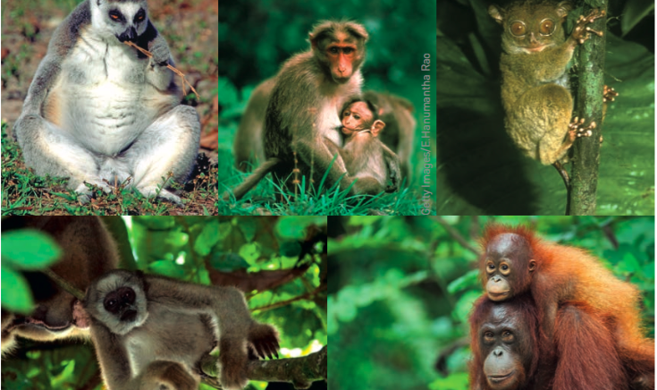
What characteristics do you have in common with these primates?

Slide 3
Syllabus point
Humans as primates are classified in the same taxonomic family as the great apes. The species within the family are differentiated by DNA nucleotide sequences, which brings about differences in:
relative size of cerebral cortex
mobility of the digits
locomotion – adaptations to bipedalism and quadrupedalism
prognathism and dentition

Slide 4
Syllabus
Humans as primates are classified in the same taxonomic family as the great apes. The species within the family are differentiated by DNA nucleotide sequences, which brings about differences in:
relative size of cerebral cortex
mobility of the digits
locomotion – adaptations to bipedalism and quadrupedalism
prognathism and dentition

Slide 5
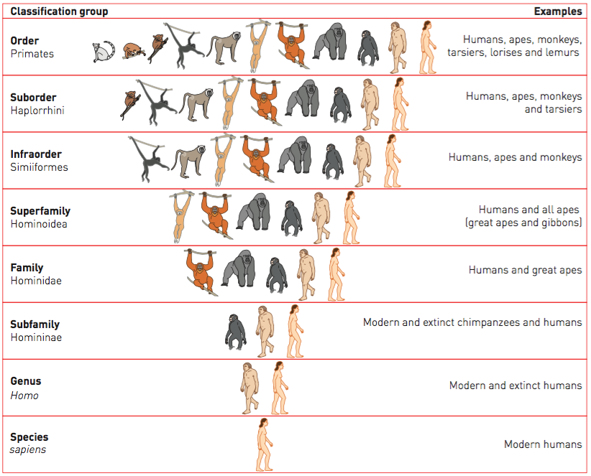
Taxanomic Family
Hominidae
Humans and great apes

Slide 6
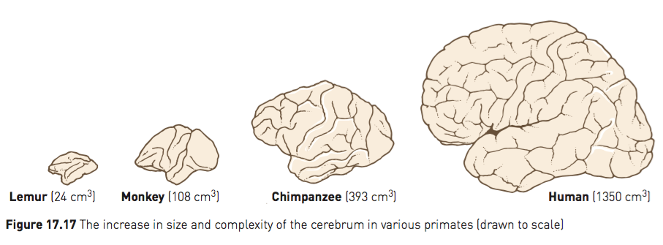
Relative size of the cerebral cortex
Increase:
size of the cerebrum taking up a large proportion of the brain
convolutions or folds on the surface of the cerebrum (increasing the surface area of the brain)
Enabled:
the development of toolmaking skills in chimpanzees and humans
complex social behaviour to develop that can respond to a variety of environmental problems

Slide 7
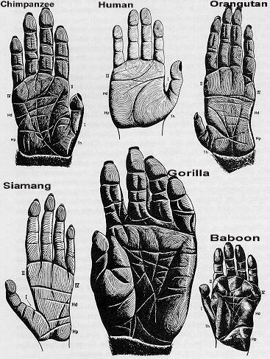
Mobility of the digits
Digits are prehensile (grasping) allowing them to wrap around branches
Opposable thumb and big toe - able to touch each of the other digits
Humans have lost their opposable big toe to enable our feet to become weight-bearing base in bipedalism
Primates have nails instead of claws – makes grasping easier
The human thumb is long and strong allowing for the greatest manipulation of objects and the ability to grasp objects with greater precision (precision grip for writing)

Slide 8
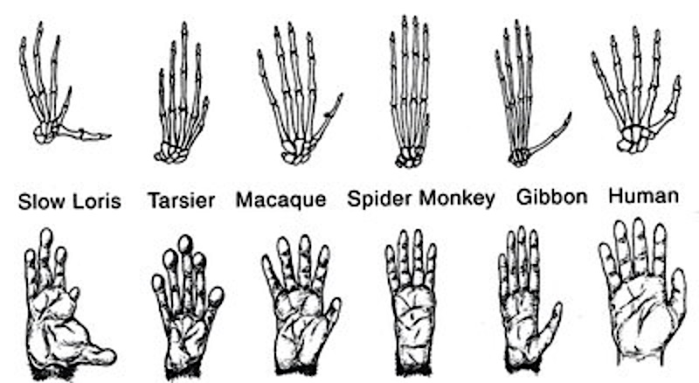
Mobility of the digits - trend
Increased:
mobility
ability to move digits independently
length of opposable digit (thumb/big toe)
primitive primates retain claws, higher primates have nails on all digits

Slide 9
Dentition
Chapter 17 - p. 258, 259, 264
Summarise notes on characteristics and trends in dentition of primates

Slide 10
Dentition
Dental formula: the number of each type of tooth in one quarter of the jaw
Primitive mammals had a dental formula of 3:1:4:3 (incisors: canine: premolars: molars)
Total of 44 teeth
Overall reduction of the number of teeth in primates
Lemur has 36 teeth with a formula of 2:1:3:3
Old world monkeys, apes and humans all have 32 teeth with a formula of 2:1:2:3

Slide 11
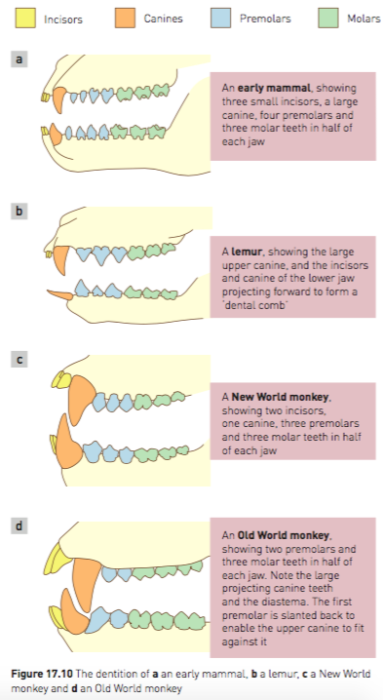
Diastema
Old world monkeys have canines that are sharp and project beyond the level of other teeth.
These primates have a gap between the second incisor and the canine on the upper teeth (called a diastema).
The crown of the first lower premolar is slanted back with a sharp edge which helps to sharpen the canine

Slide 12
Other trends
Sense of smell
Reduced with gradual reduction in length of snout
Vision
Eyes becoming more forward facing to allow for stereoscopic vision
Eyes gradually becoming enclosed in protective bony socket
Increased proportion of cerebrum devoted to vision

